Slide 1

The role of innovative thinking
Dr. Hegyi Barbara
bhegyi@inf.elte.hu

Slide 2
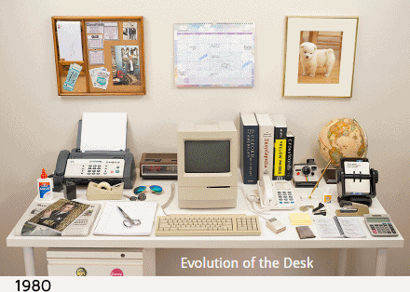
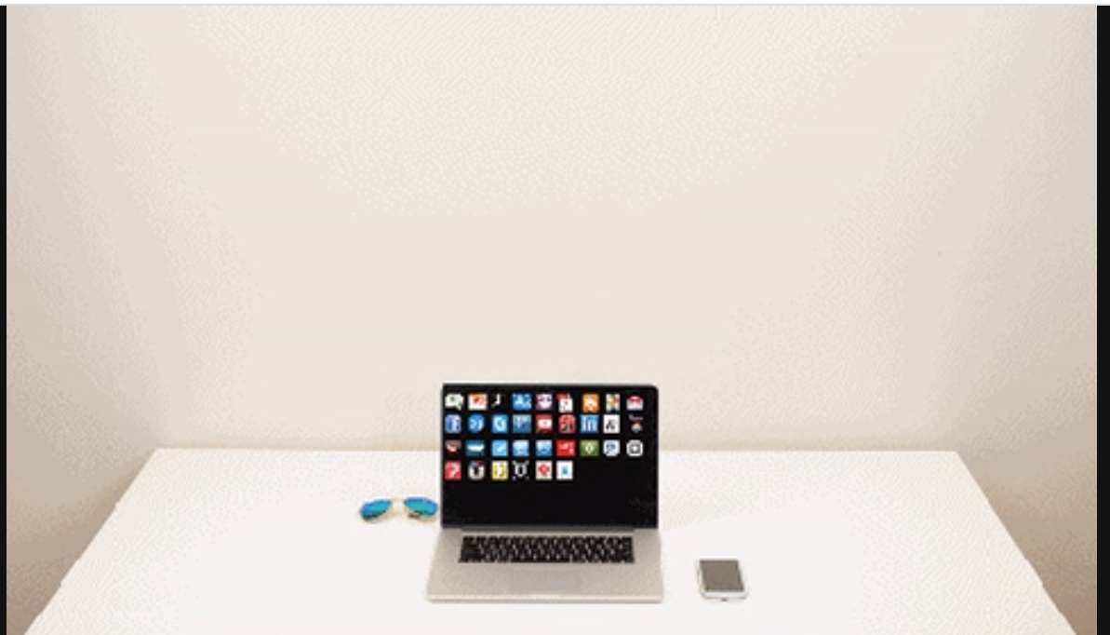
Where innovation leads us?
GIPH: https://giphy.com/gifs/evolution-desk-hsmTy1tNNrS5q

Slide 3
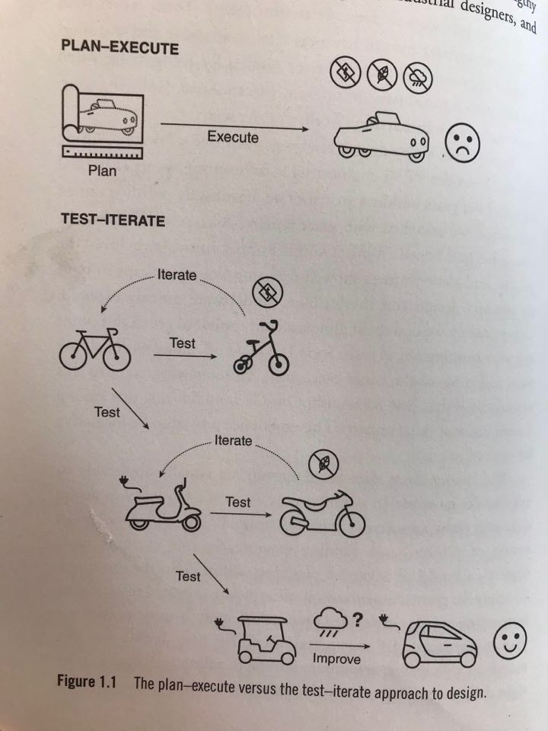
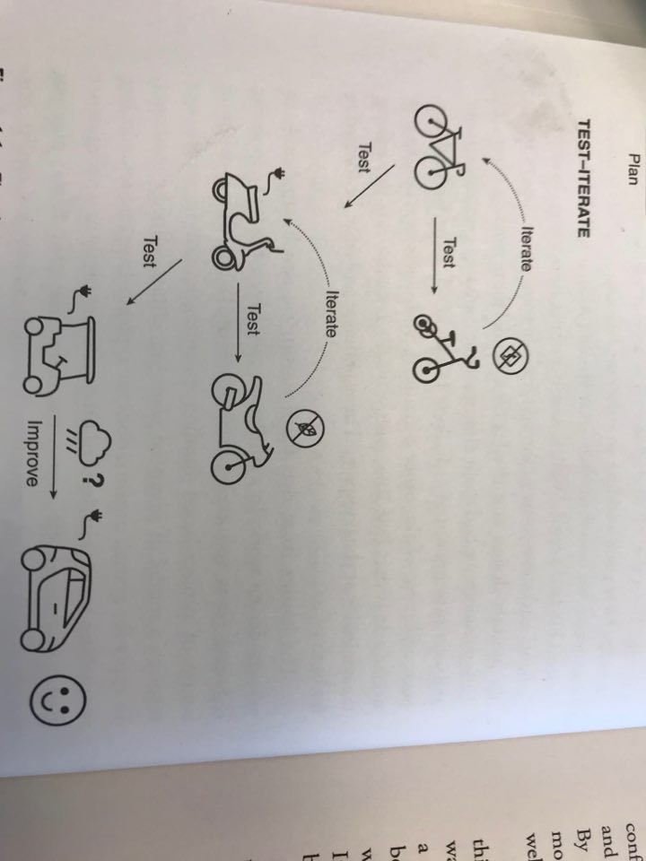
The LEAN concept

Slide 4
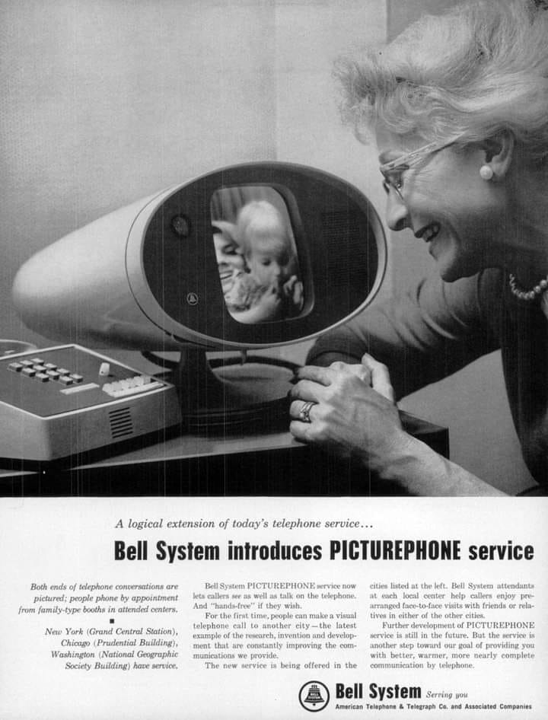
Video calls…. 1964

Slide 5
Our ecosytem – inspiring examples and opportunities

Slide 6
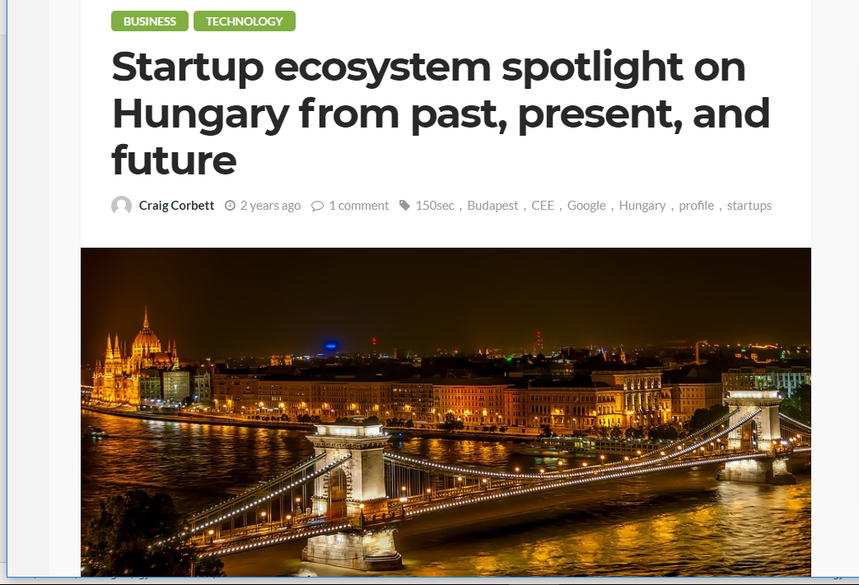
Forrás: https://sociable.co/technology/startup-ecosystem-hungary/
„If you are looking for an abundance of startups in Hungary, make a beeline for the capital.
Budapest, the capital city of Hungary, has marked its position in Europe as an up-and-coming tech hub.
Nowadays, Budapest — and in turn the rest of the country — has been placed in the international spotlight by Unicorn Prezi, and is becoming increasingly attractive to startups tempted by an affordable talent pool of developers and engineers, a startup-friendly government, access to funding from the EU and increasingly active homegrown VCs.”

Slide 7
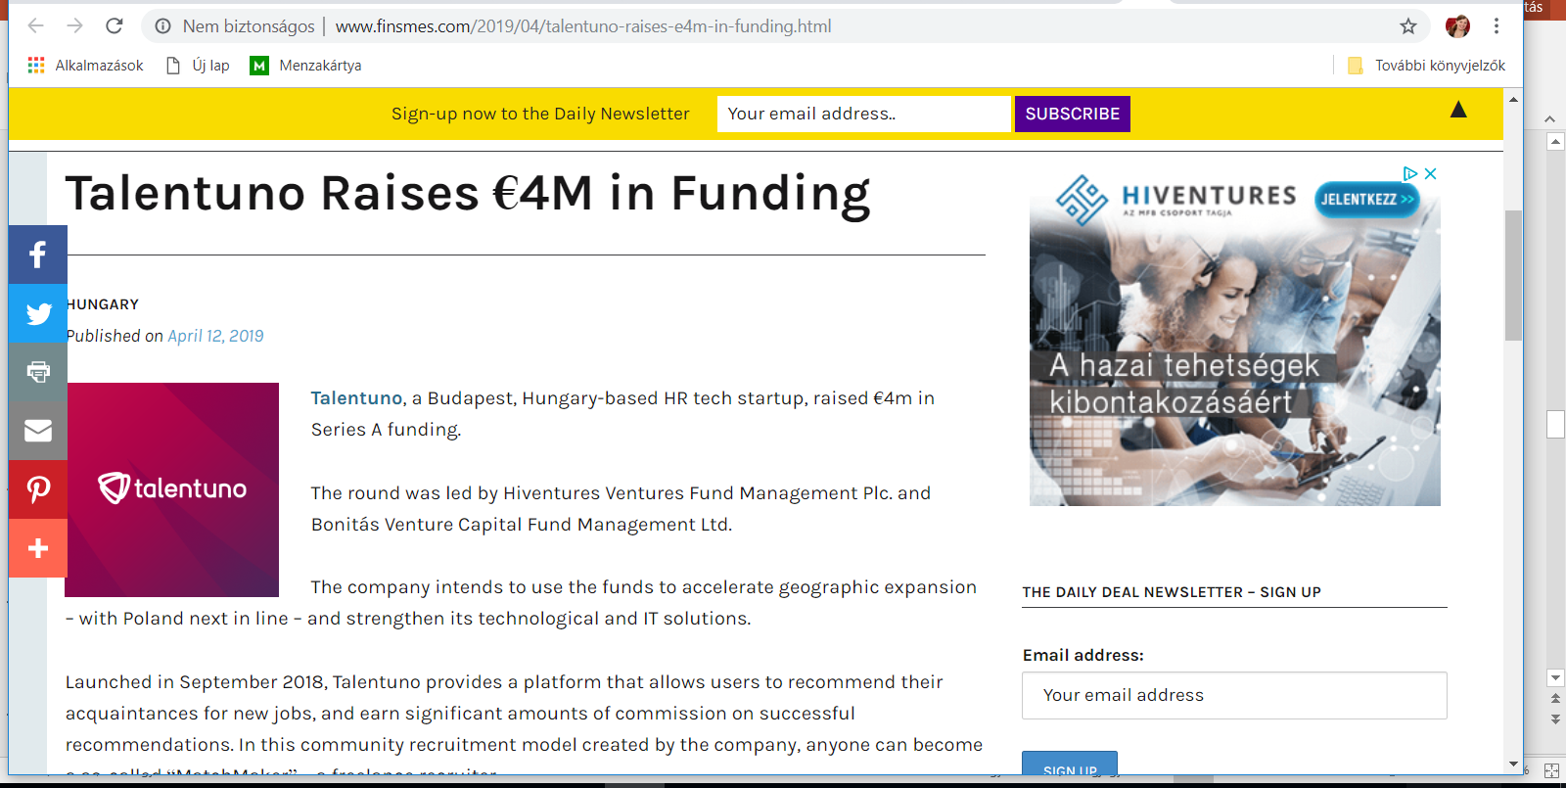

Slide 8
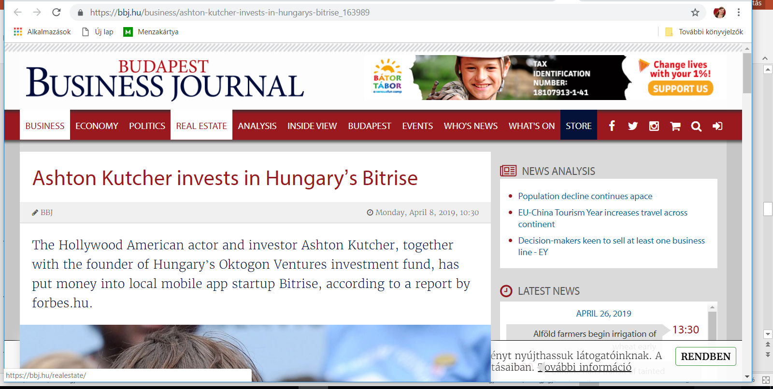

Slide 9
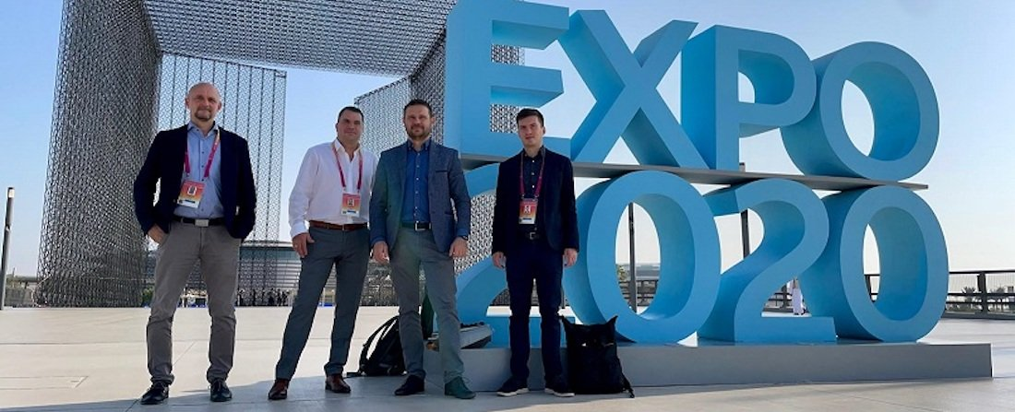
Nagy befektetést kapott a magyar okosotthonos startup - Chameleon Smart Home

Slide 10

SEON raised $94,000,000 / Series B from Creandum and 2 other investors
SEON is an online fraud prevention platform that detects and stops fraud in real-time through transactional data analysis.

Slide 11
You had great ideas …let’s see some of your competitors
Smart home,smart clothing, new methods in education and tackling pandemics

Slide 12
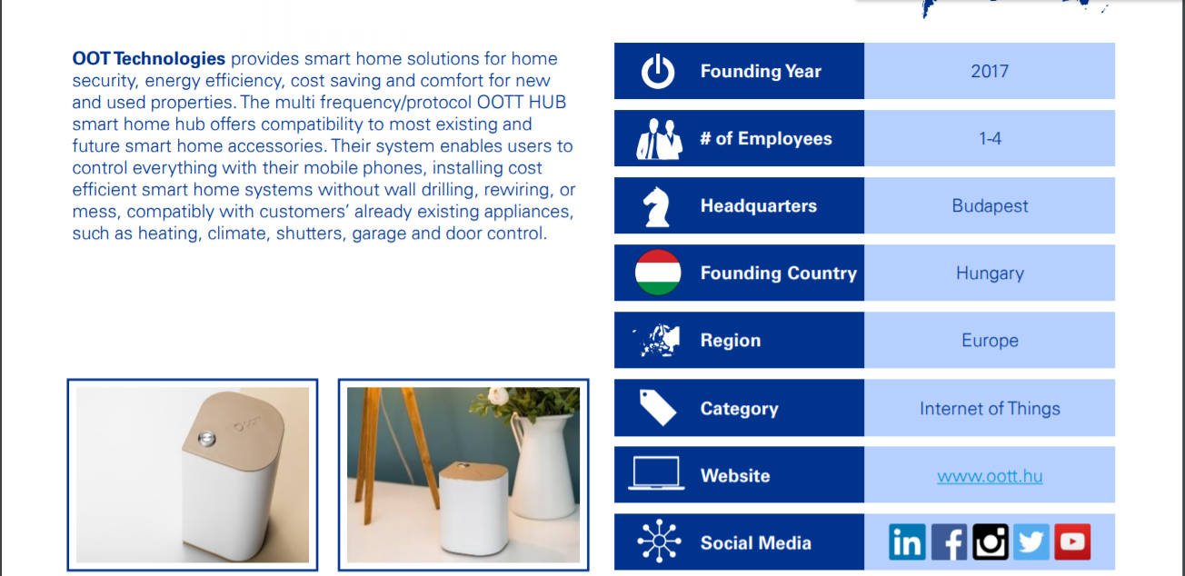
https://assets.kpmg/content/dam/kpmg/nl/pdf/2019/advisory/kpmg-real-estate-advisory-4th-edition-june-2019.pdf

Slide 13
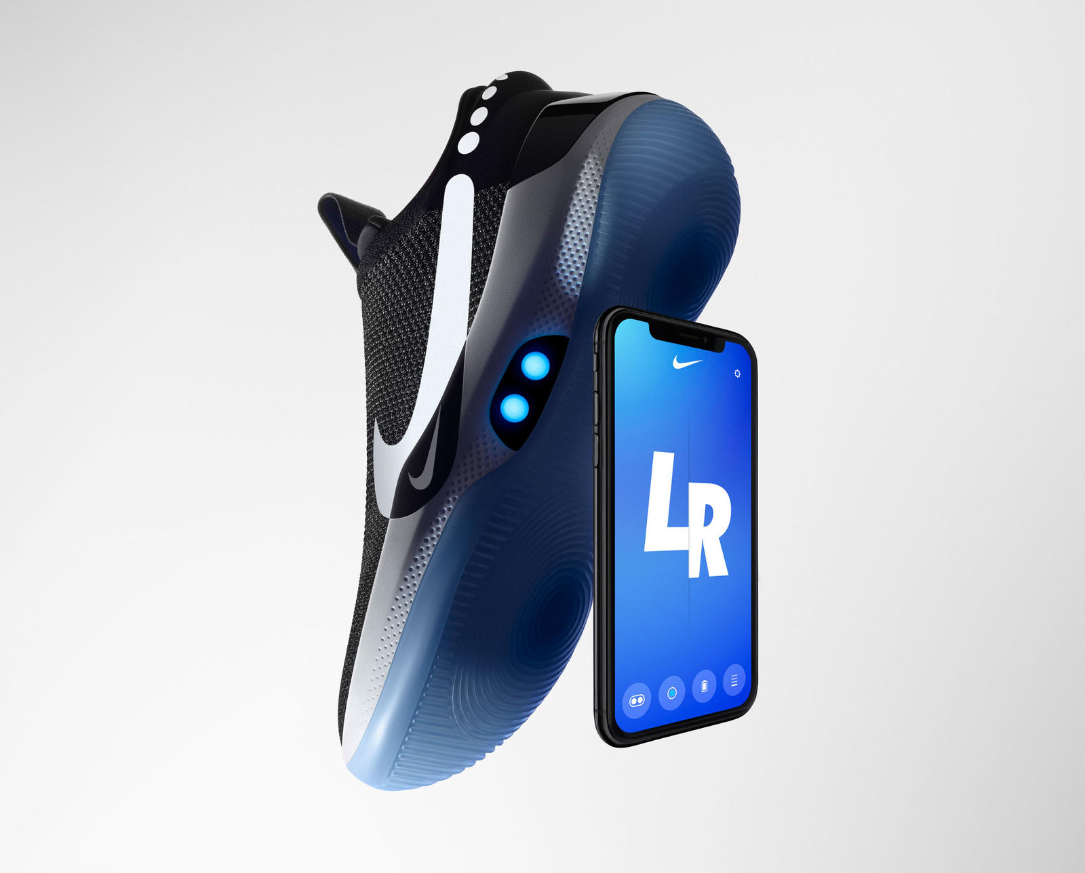
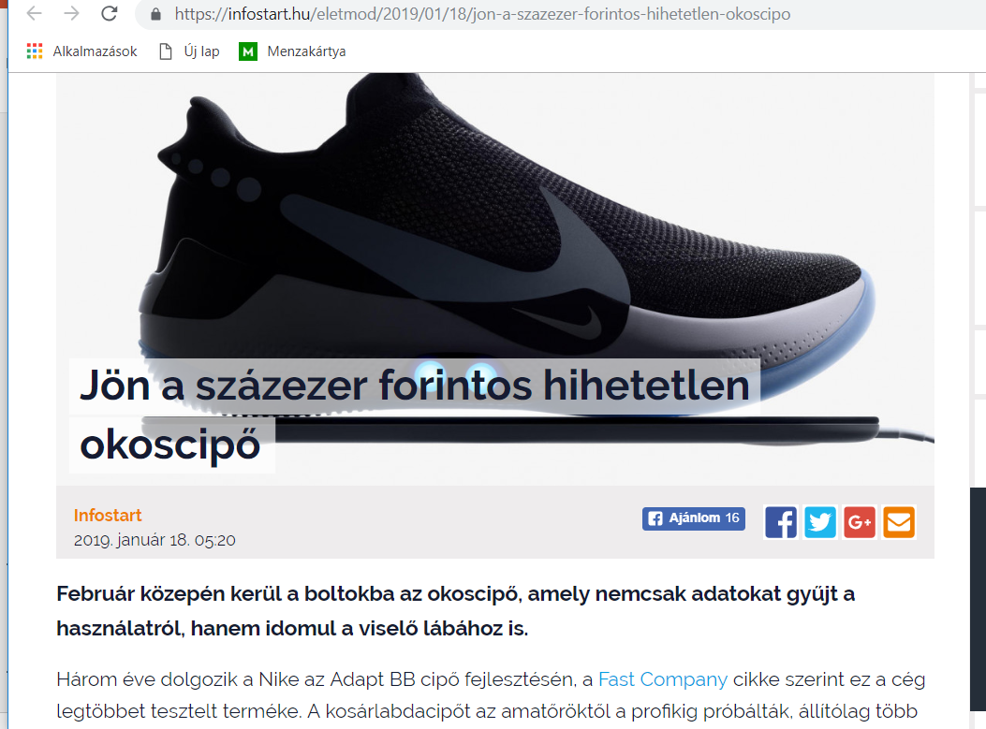
NIKE adapt BB
Nike Adapt BB (basketball) is the first continually updated performance product from Nike due to the near-symbiotic relationship between the shoe’s digital app and the shoe’s opt-in firmware updates.
Because the needs of the foot change at any given time based on the sport, its duration and on specific movements, like a slashing cut to the basket, "perfect fit" is a floating target.
As the FitAdapt system hones the quality of fit in basketball, the next step will be to bring FitAdapt to other sports and lifestyle products, each with unique demands for fit in different environments.
https://news.nike.com/news/nike-adapt-bb

Slide 14
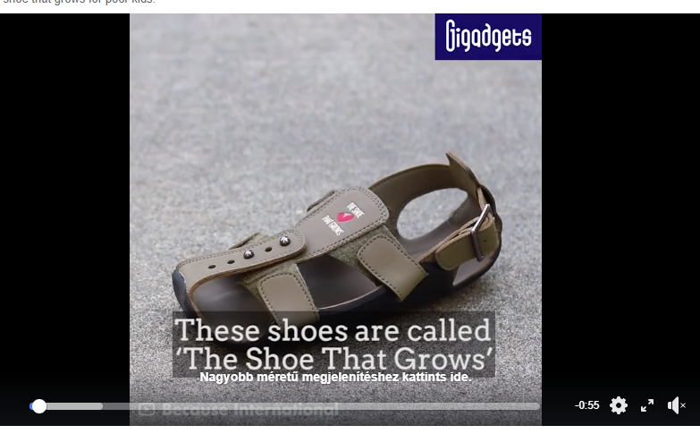
The shoe that grows

Slide 15
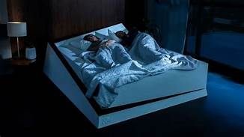
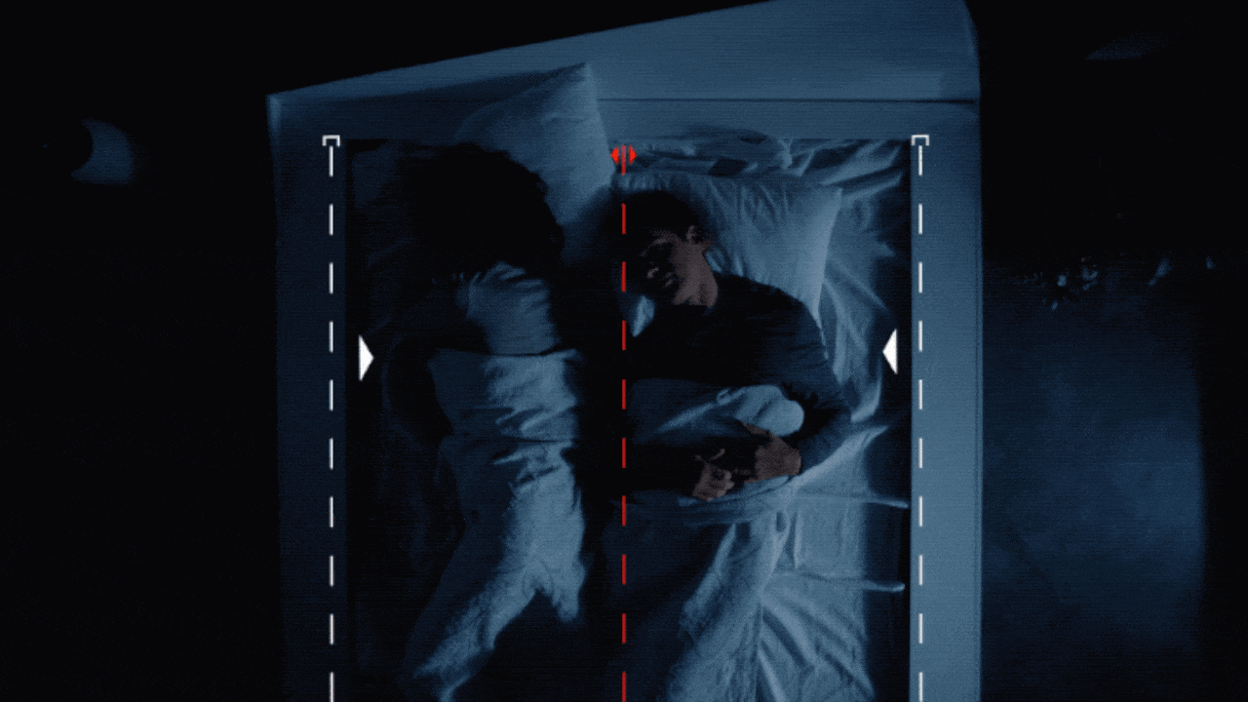
Ford’s smart bed for couples
It’s called the Lane-Keeping Bed and, according to the automaker, “applies car tech know-how to ensuring that even the most selfish bed mate stays firmly ‘in their lane’ through the night.”
https://www.motor1.com/news/305102/ford-smart-bed-keep-lane/

Slide 16
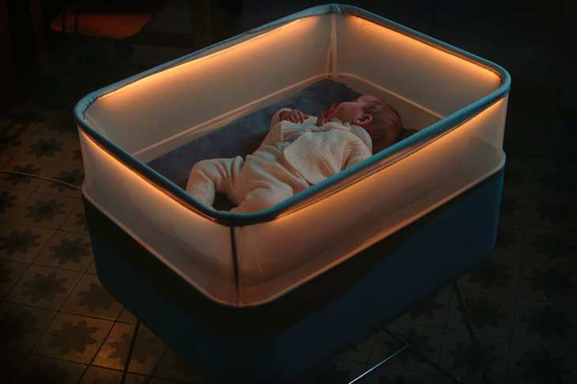
This Ford crib simulates a driving car to put your baby to sleep

Slide 17
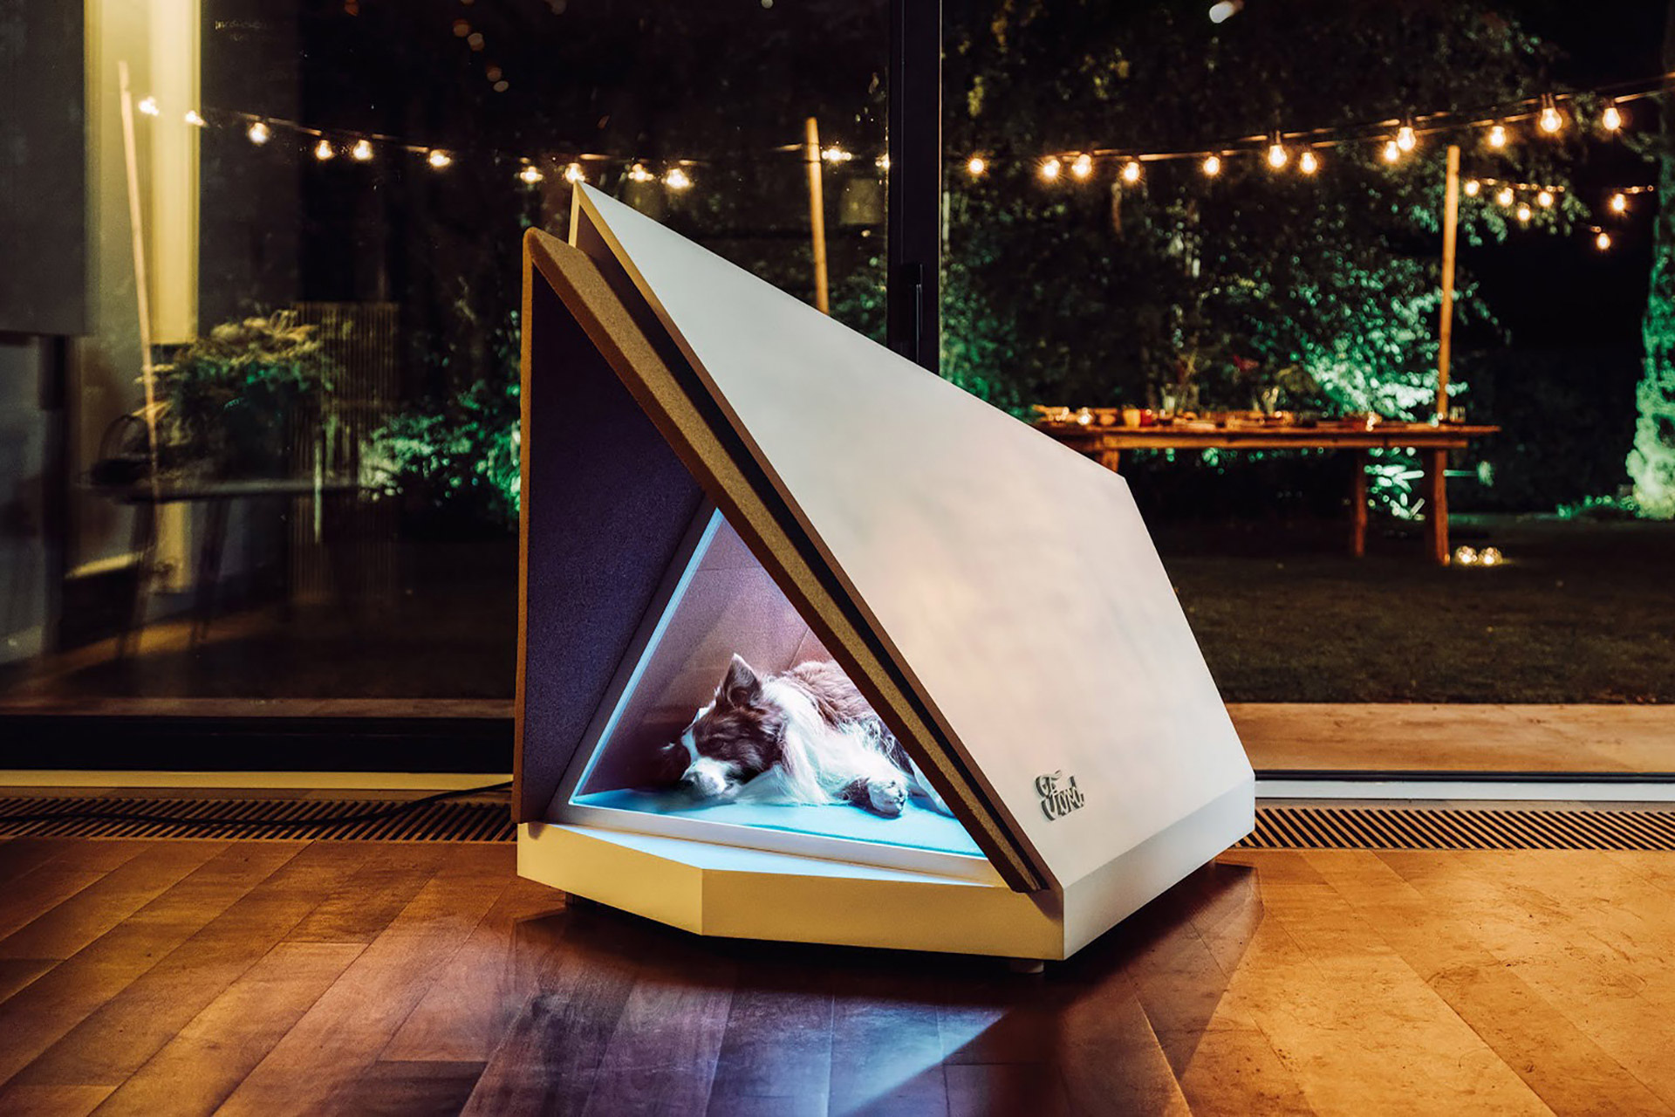
Ford's noise-cancelling kennel shields dogs from fireworks
https://www.dezeen.com/2019/03/14/ford-noise-cancelling-kennel-design/

Slide 18
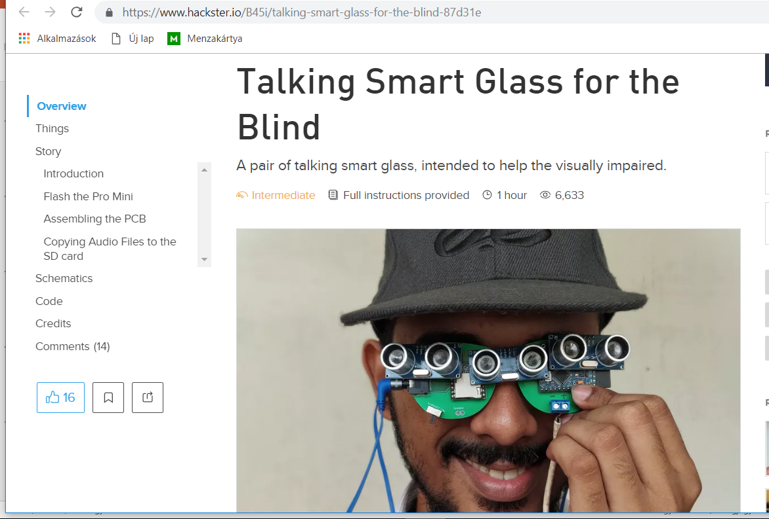

Slide 19
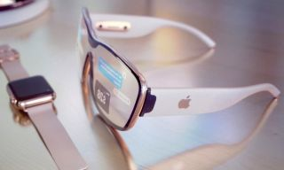
Apple smart glass…

Slide 20
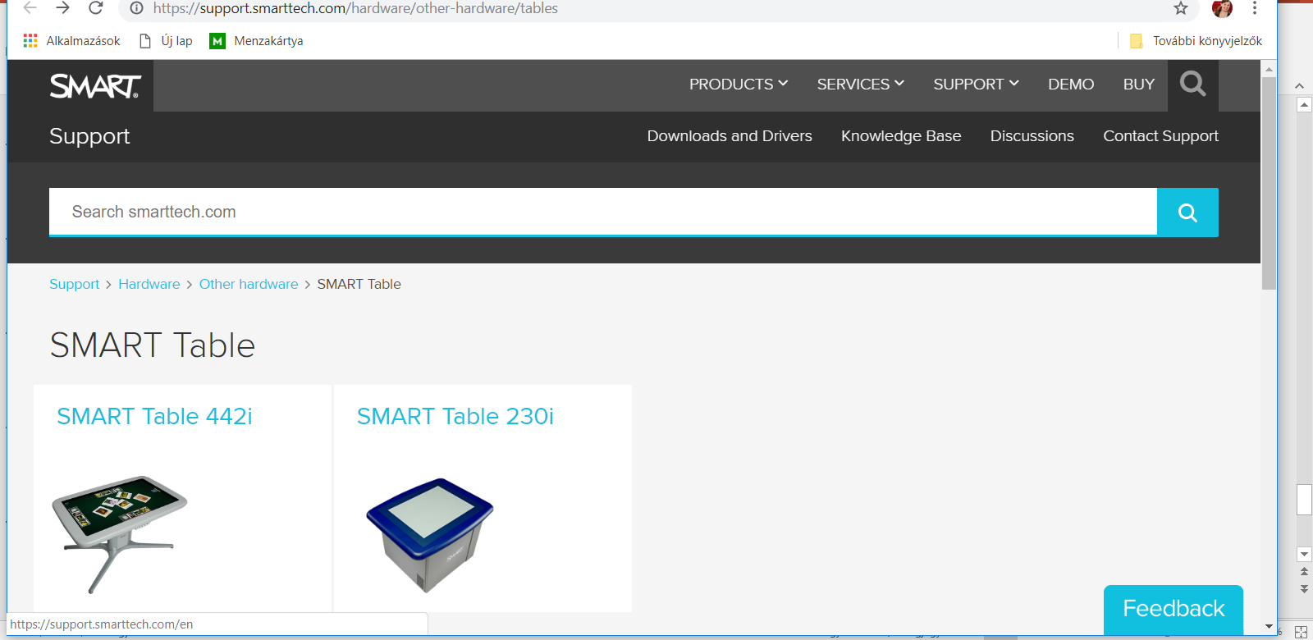

Slide 21
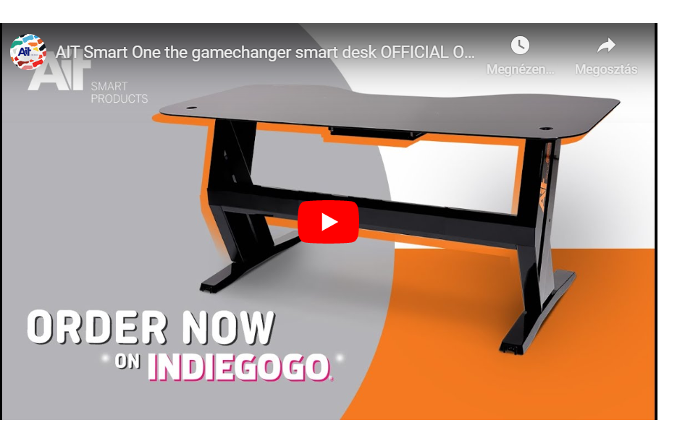
Hungarian successful smart table
- with built in fitness-feature

Slide 22
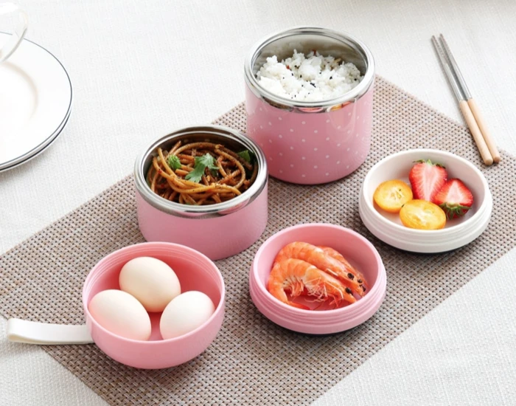
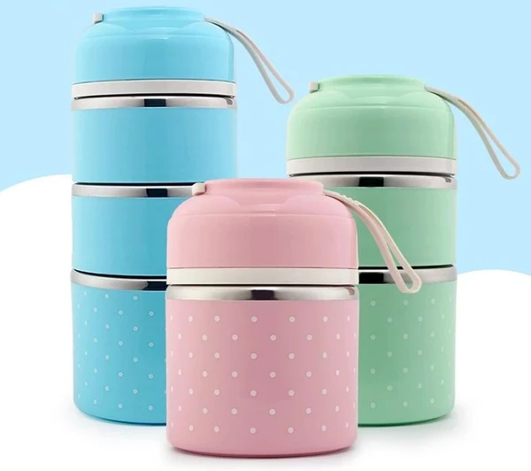

Premium Lunch Box
„Thermal benefits. The double-walled vacuum insulation ensures that your food stays hot for 2-3 hours and cold for 4 hours. Food can be added and kept warm and cold at different levels!”
„Our Premium Cuplies™ helps you to achieve the goals of your diet. Because this lunch box is super cute, we will tell you that you will be motivated to take your lunch with you every day, even if it's a day off!”

Slide 23
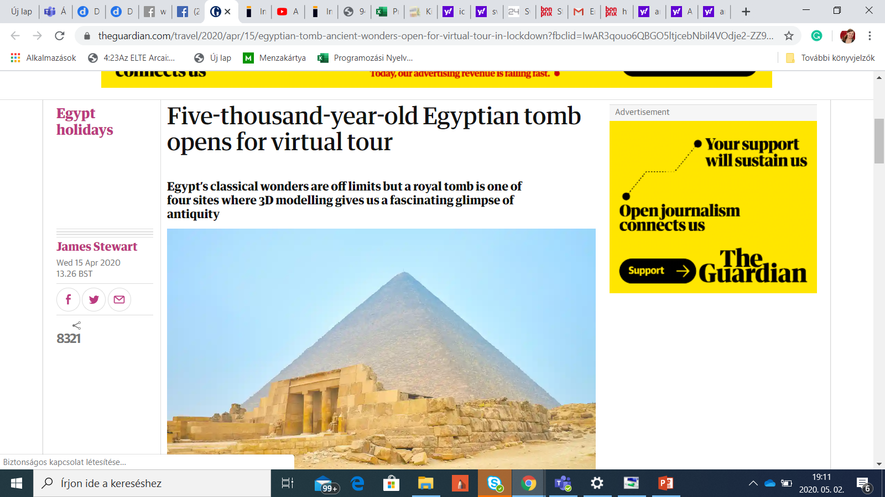
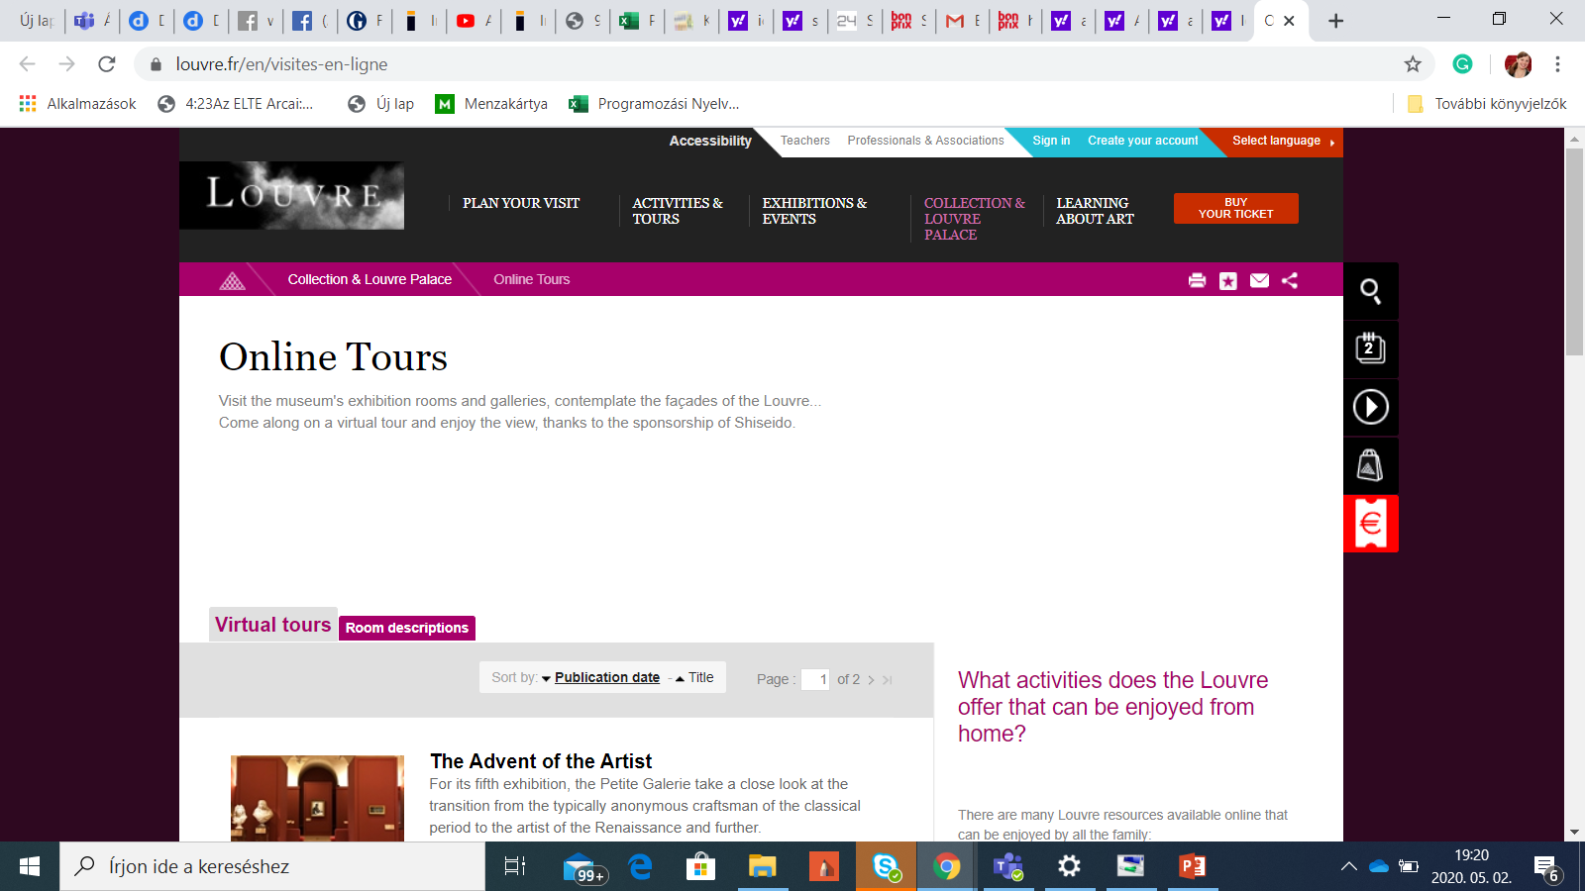

Slide 24
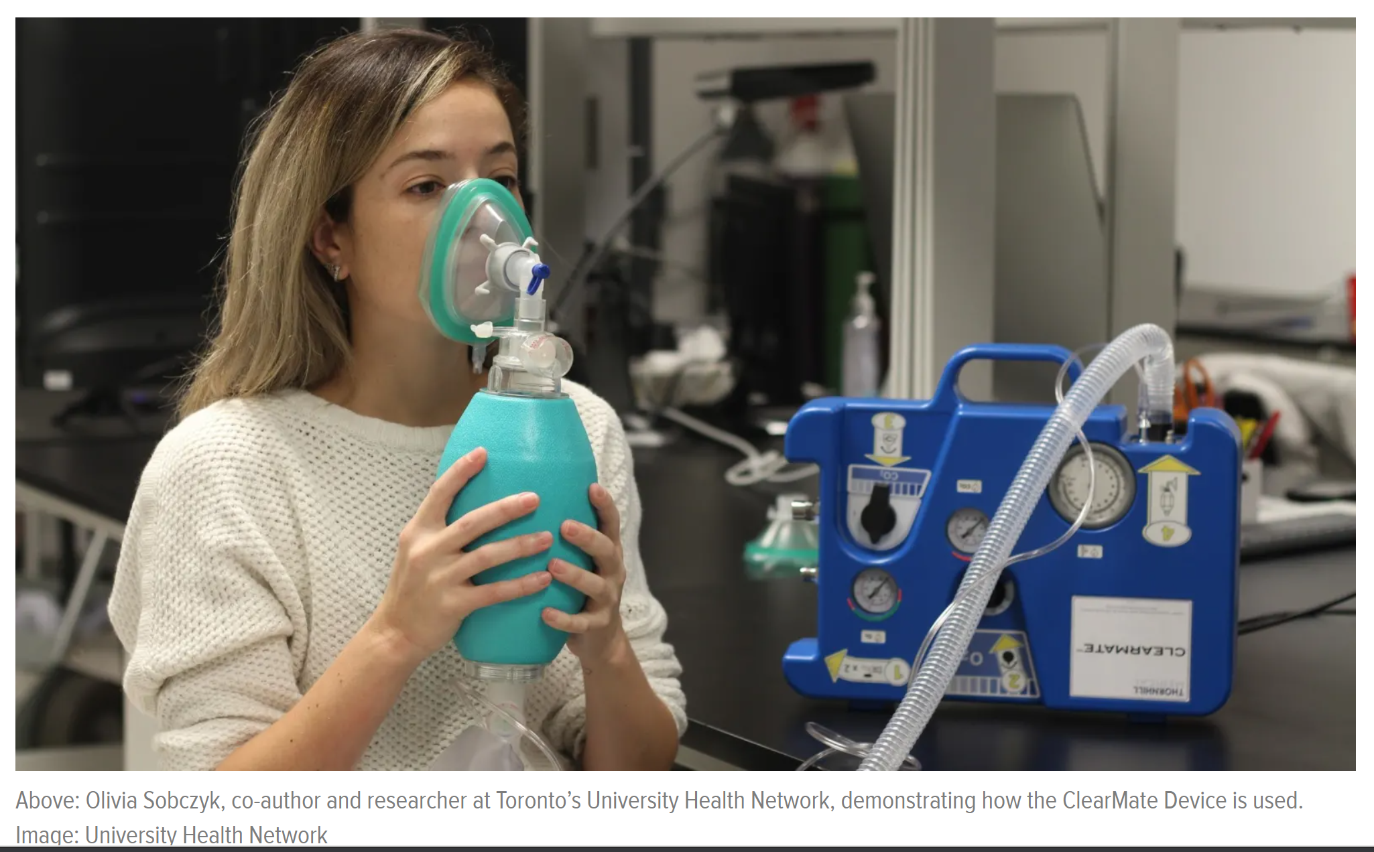
Simple Invention Helps You Sober Up by Exhaling Alcohol

Slide 25
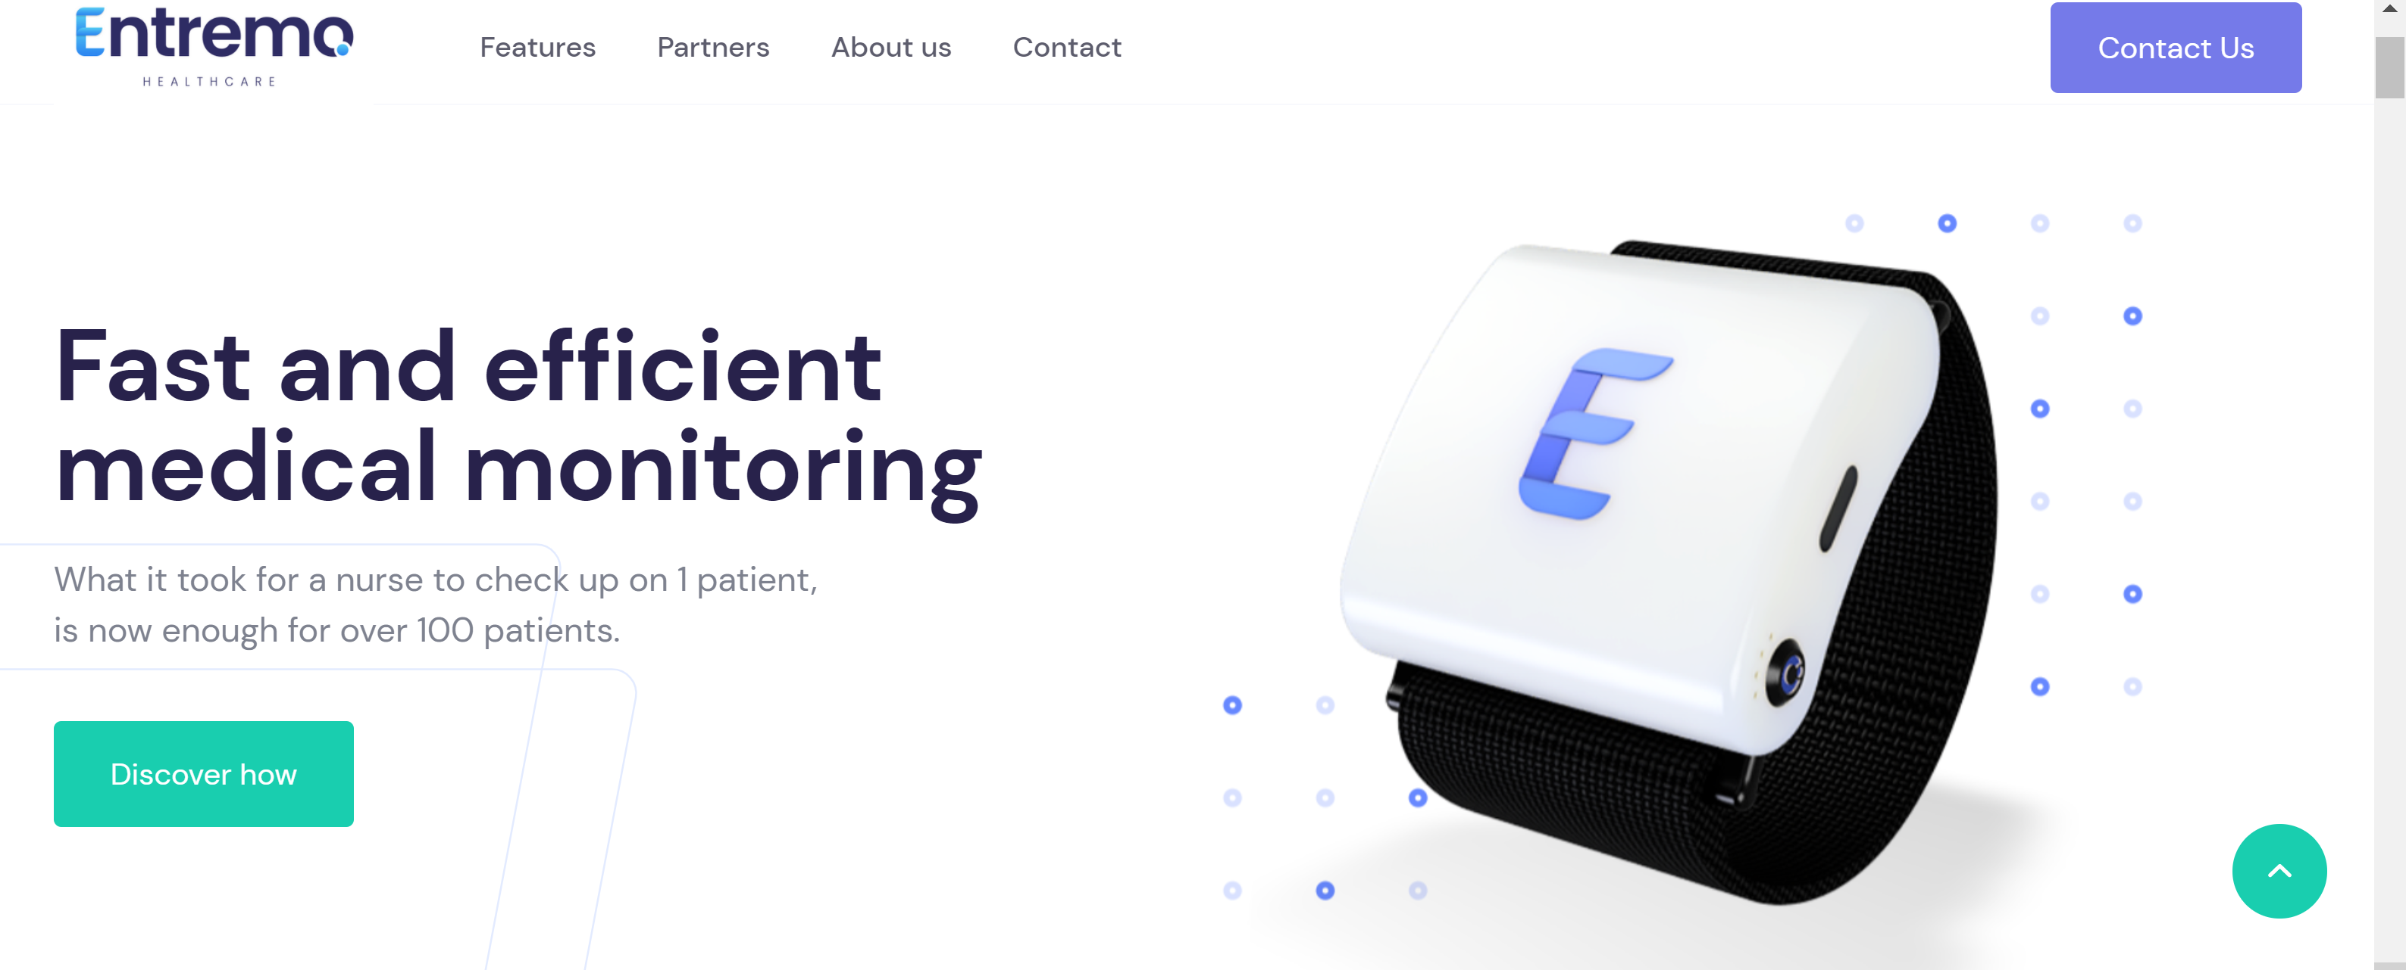

Slide 26
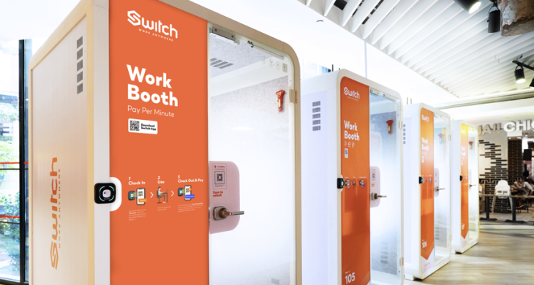
Former WeWork China exec launches a ‘startup studio’ for real estate

Slide 27
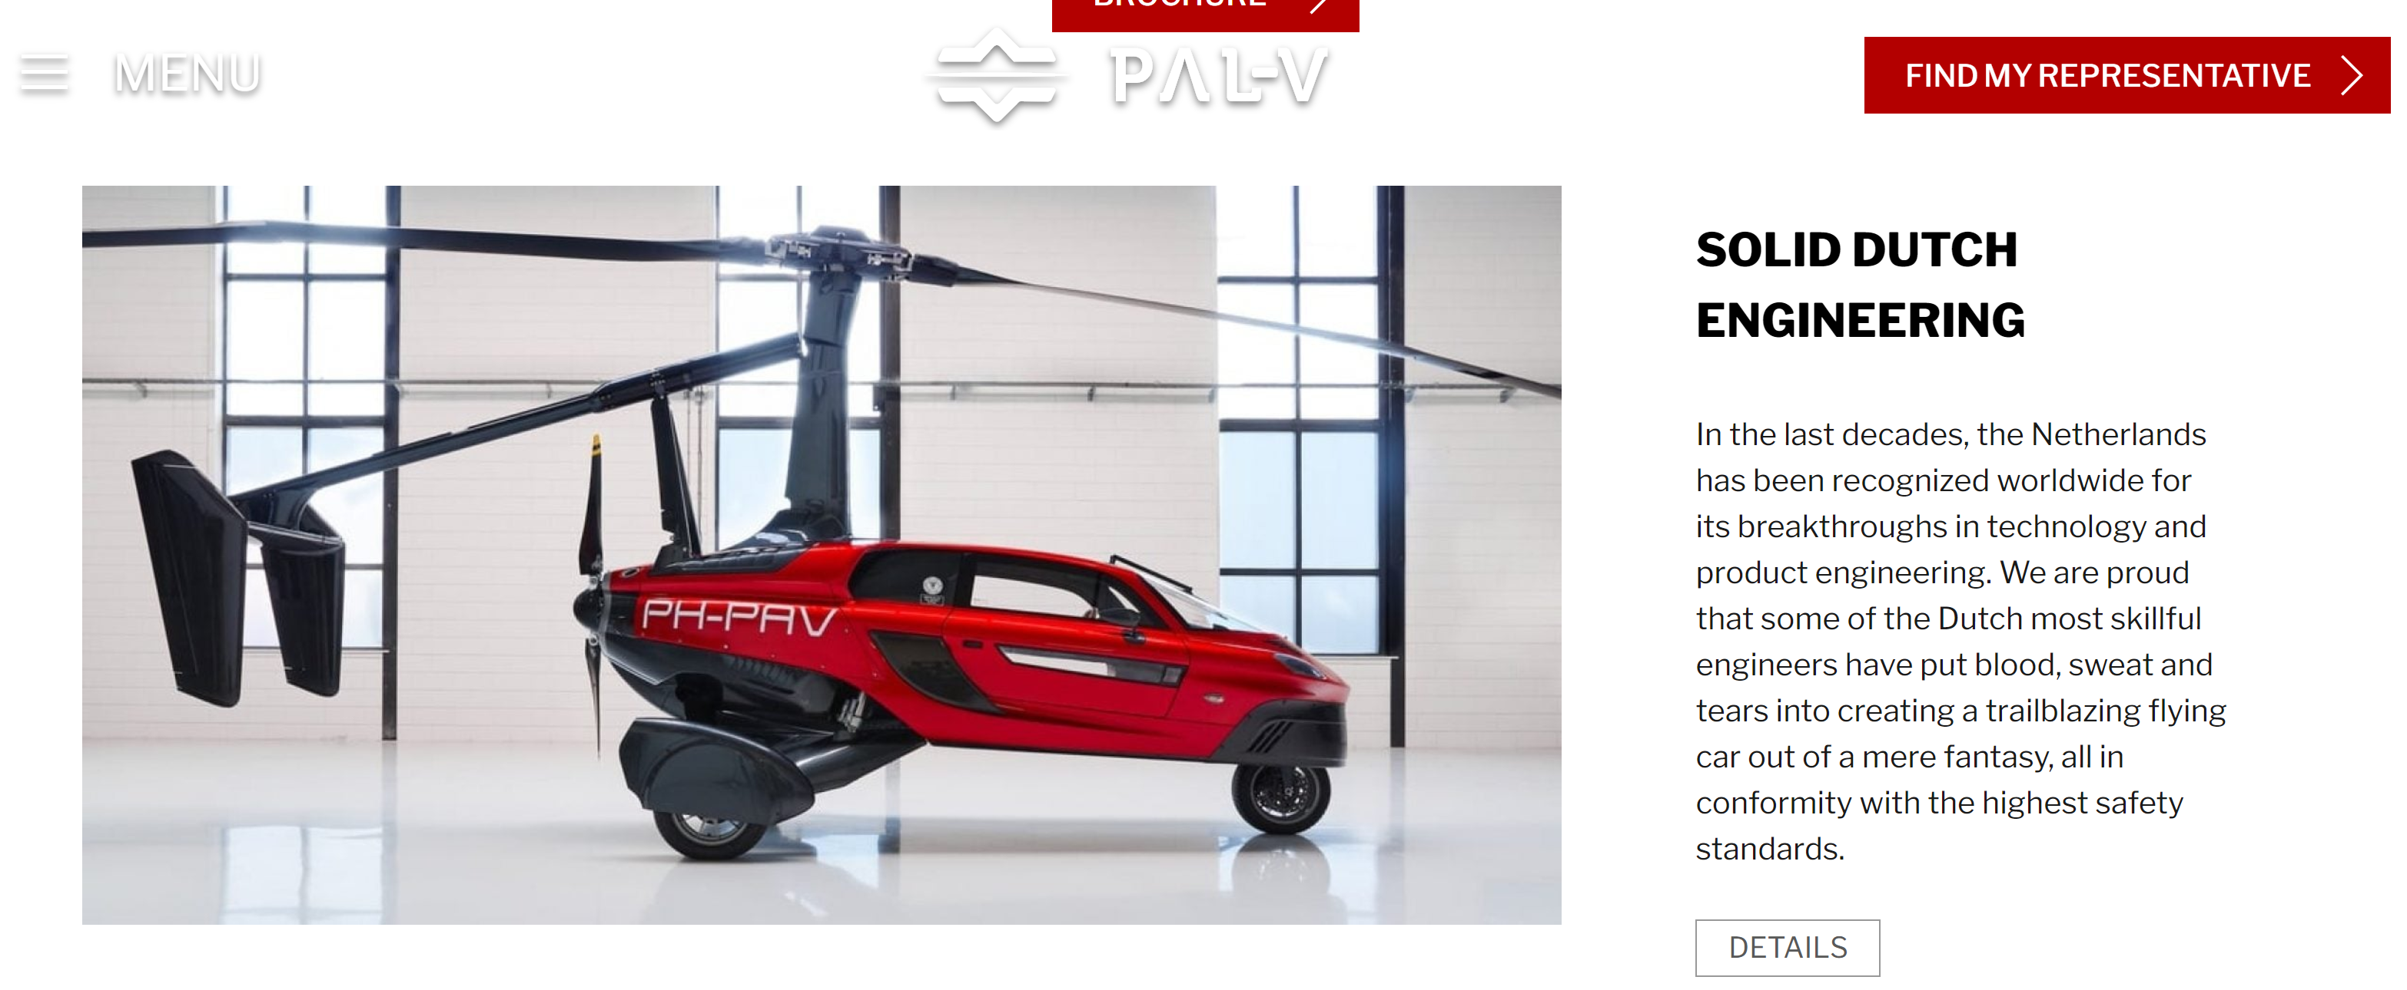
Flying cars

Slide 28

Competitor to Neuralink
- The Stentrode, a minimally invasive, fully implanted wireless device that transmits signals from the brain’s motor cortex, can help people with upper limb paralysis control a digital device without using their hands, a study shows.

Slide 29
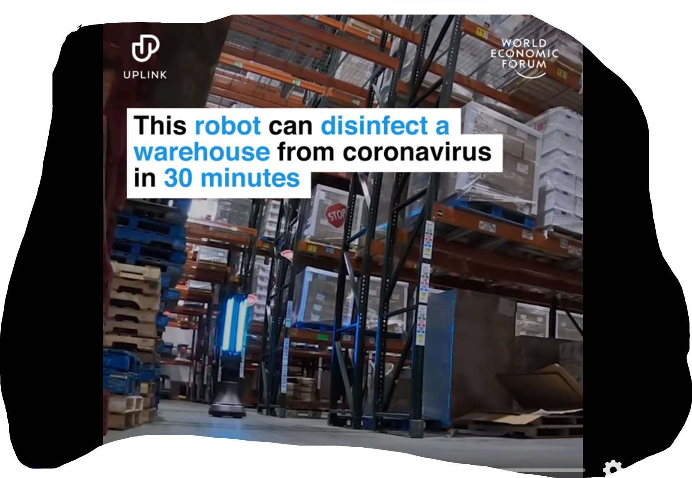
This MIT-designed robot can disinfect a warehouse of COVID-19 in 30 minutes

Slide 30
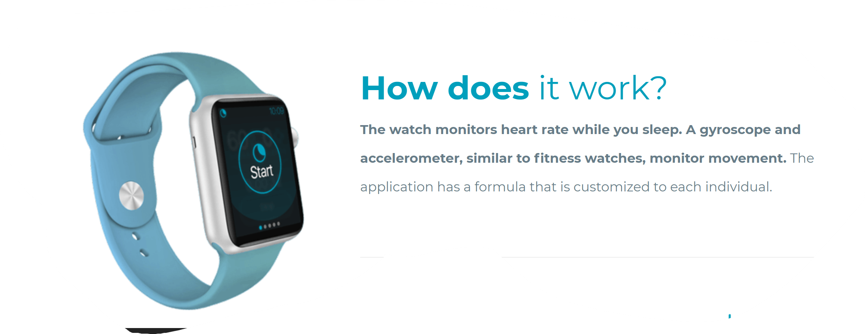
Stop nightmares!

Slide 31

…but your ideas were better, hope you had fun developing them!☺

Slide 32

Adaptation to the needs of the customers, clients and turning problems, market changes into new opportunities

Slide 33
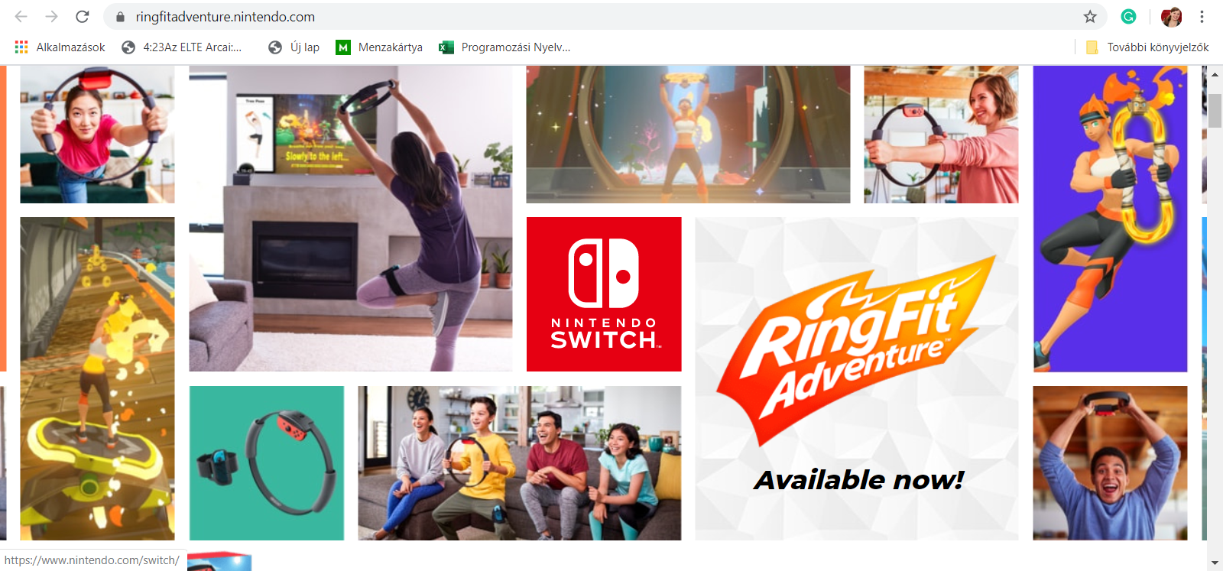
Nintendo Fit Ring

Slide 34
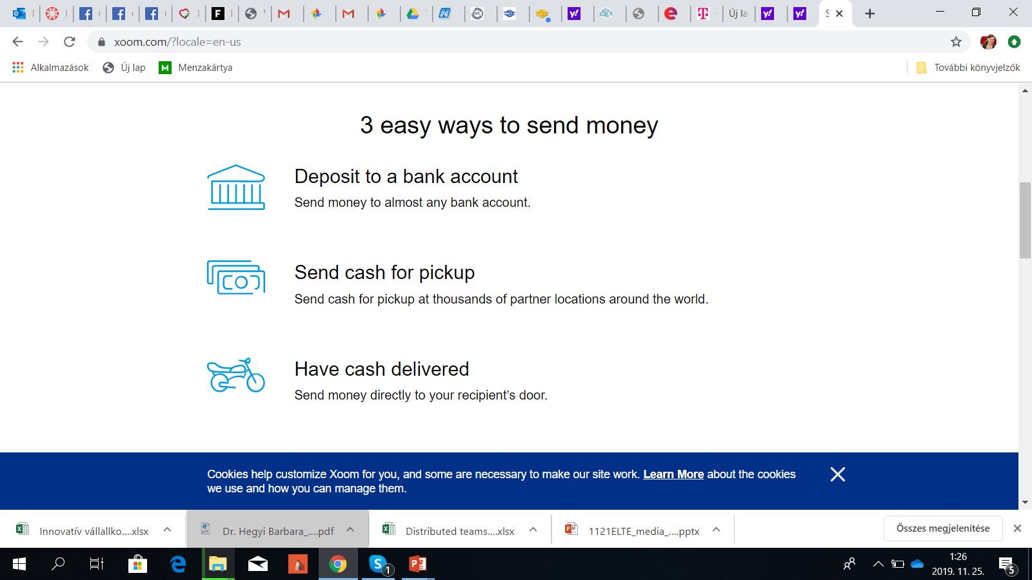


XOOM
Fast bank deposits
or cash pickup

Slide 35
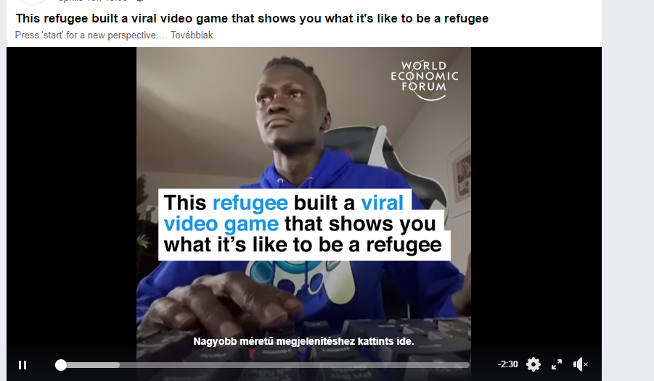

Slide 36
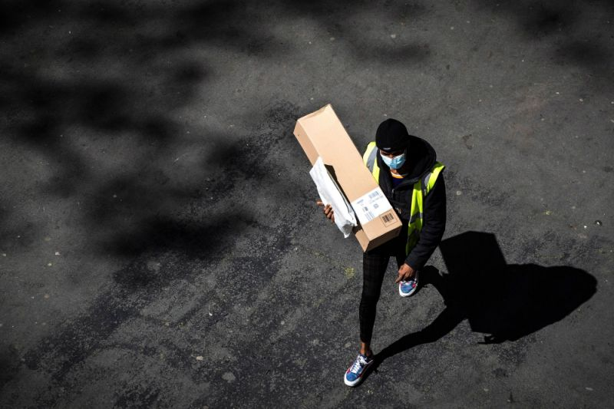
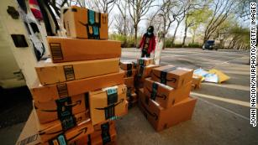
Amazon is hiring 75,000 more workers to keep up with demand during pandemic
Amazon Has a Europe Problem: Unions and Regulators Are Circling

Slide 37
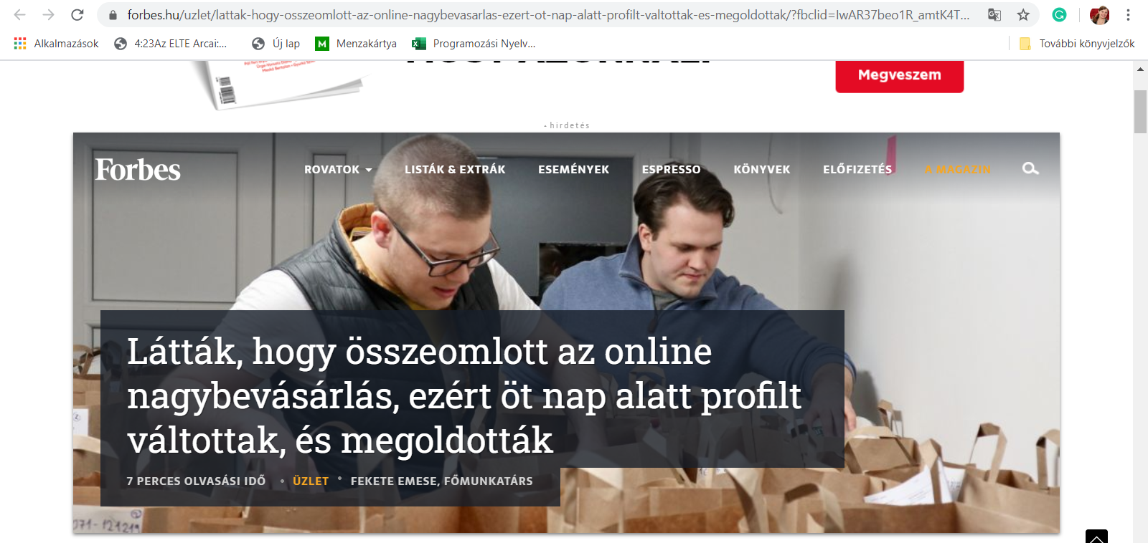
Finding your market niche (B2C – webshop and delivery service)

Slide 38

Japan taps an unexpected drugmaker for its coronavirus treatment
Shares in Fujifilm Holdings Corp jumped as much as 8.8% on Tuesday after the Japanese government said it would recommend the use of Fujifilm's anti-flu drug Avigan to treat people sickened by coronavirus.
Japanese Health Minister Katsunobu Kato said the ministry would recommend the drug for use in coronavirus treatments after test dosages appeared effective in mild and asymptomatic cases at at least two medical institutions over the weekend.

Slide 39
Leadership, startups and sustainability
USP, social responsibility and growth

Slide 40
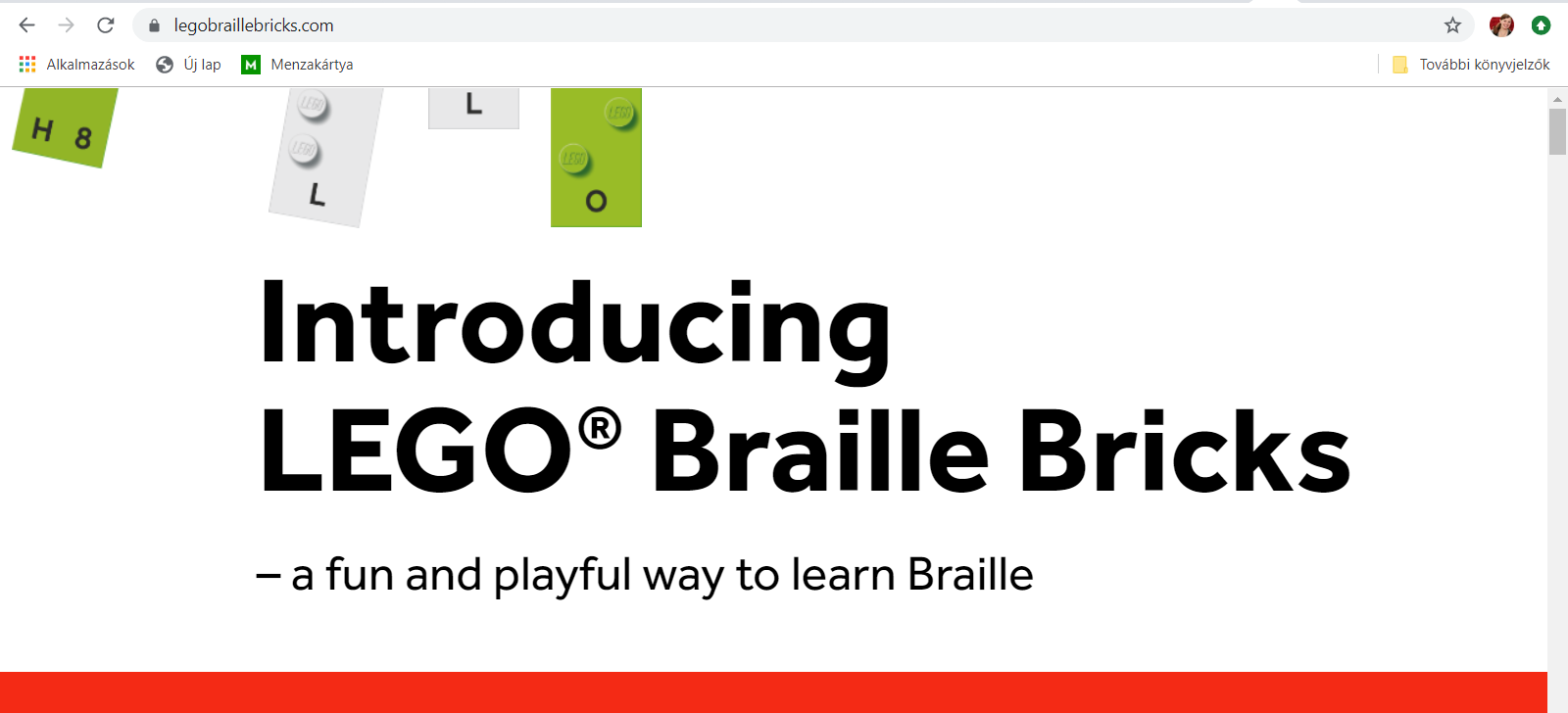


Slide 41
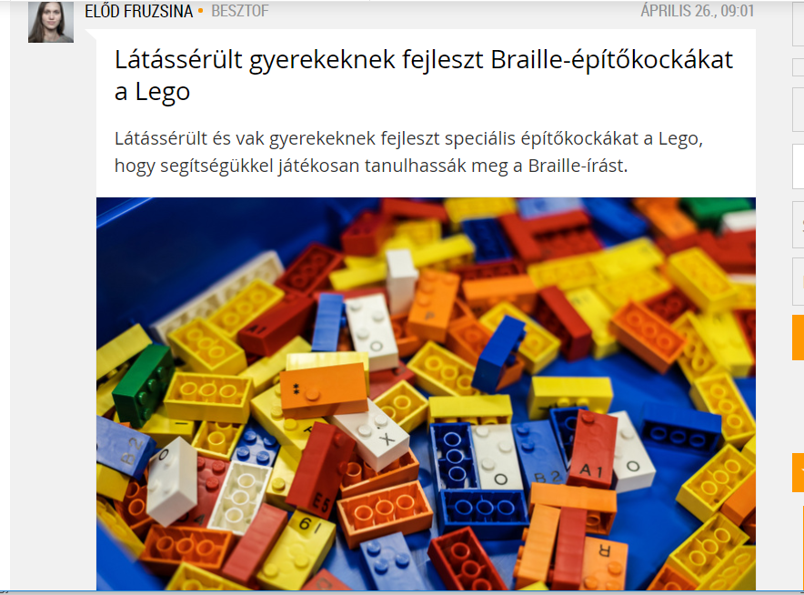
Innováció összekapcsolása társadalmi célokkal
Forrás: https://index.hu/mindekozben/poszt/2019/04/26/latasserult_gyerekeknek_fejleszt_braille-epitokockakat_a_lego

Slide 42
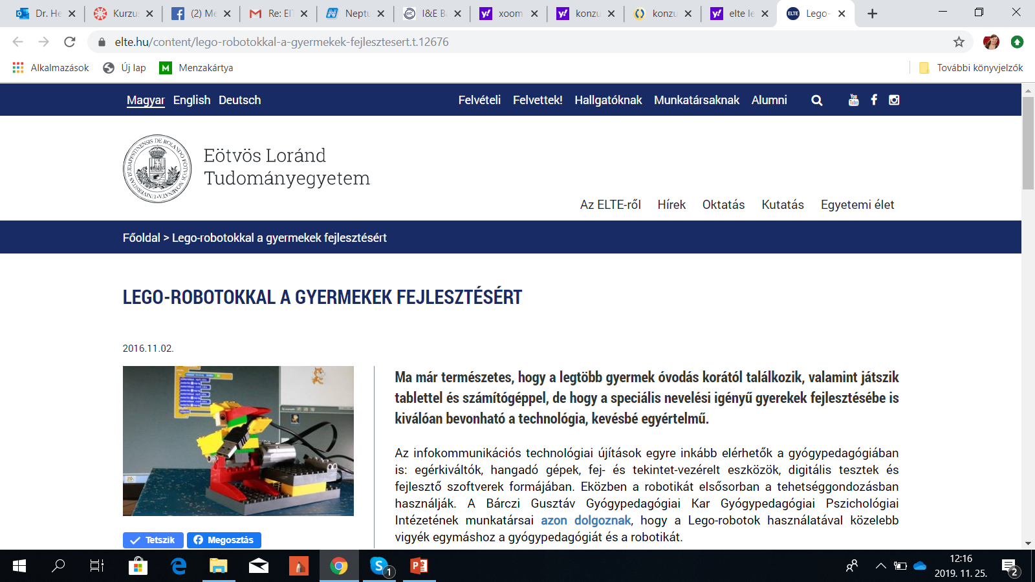

Slide 43
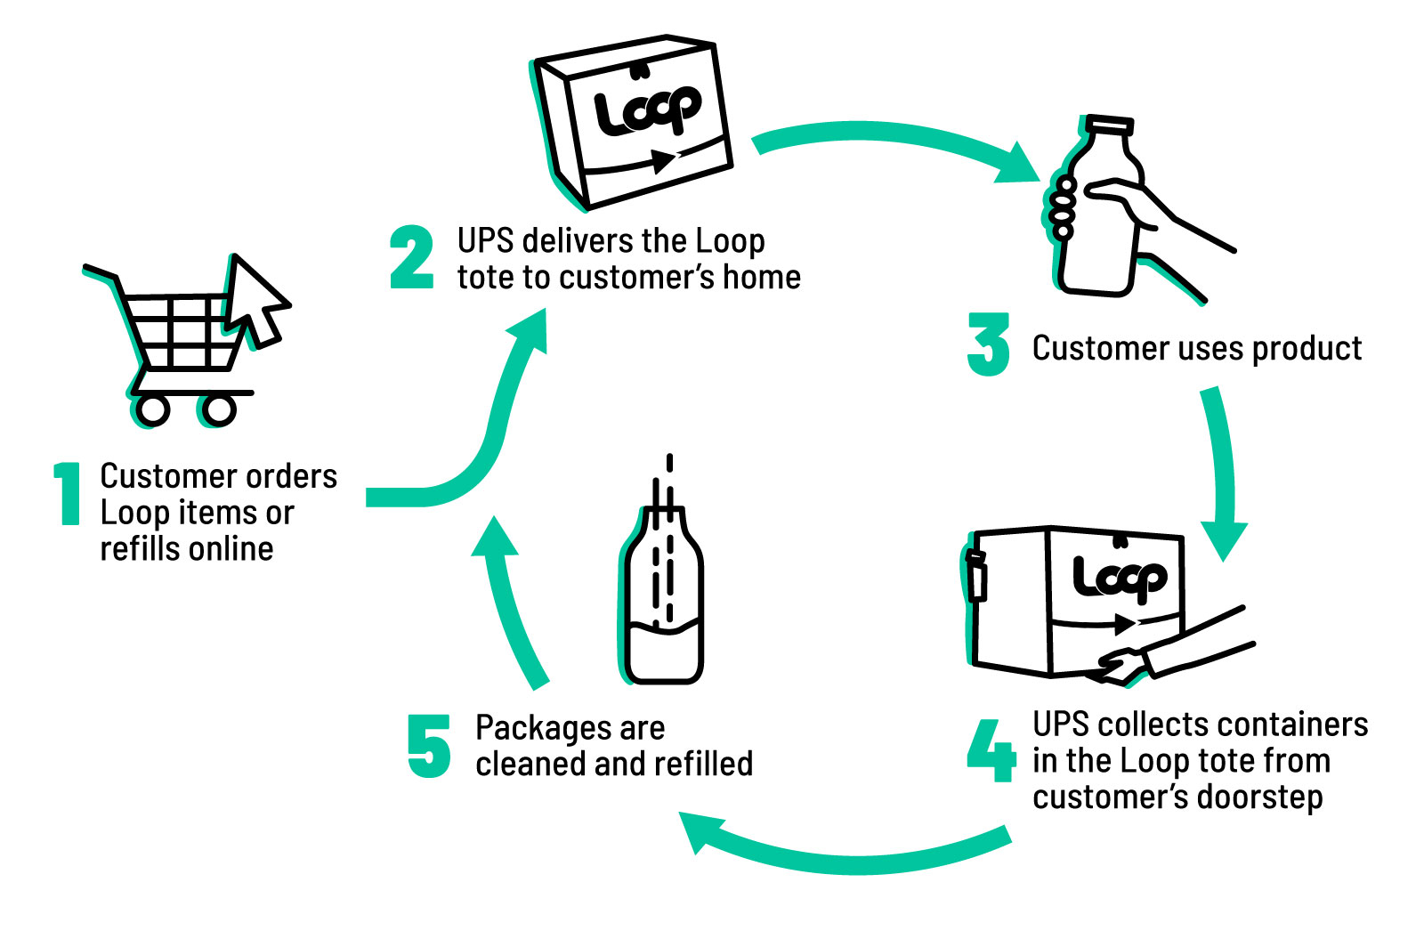
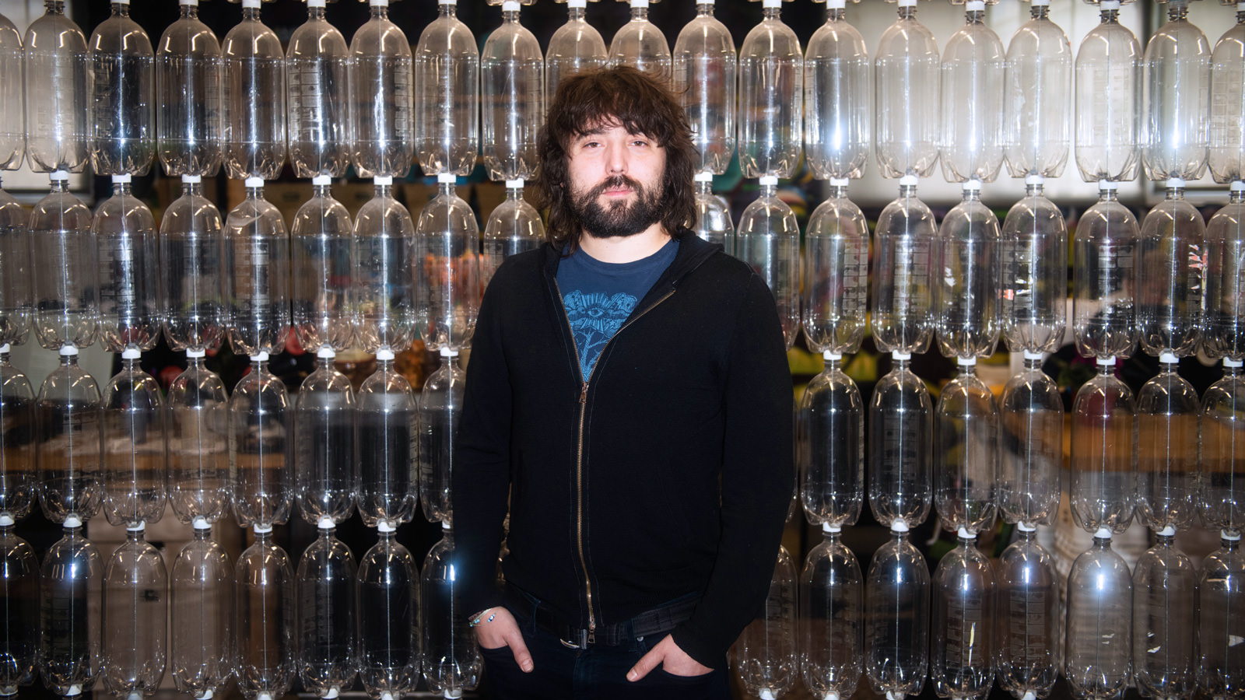
How to solve the world’s plastics problem: Bring back the milk man LOOP – Reuse the trash and provide unique service

Slide 44
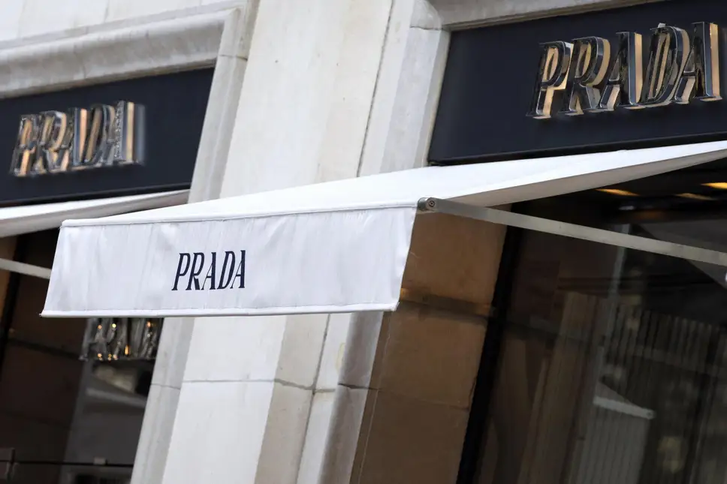
Prada makes history as the first luxury brand to sign a sustainability deal
… now Prada has made history as the first luxury brand to obtain a loan from French banking group Crédit Agricole with stringent sustainability-related conditions attached to it.
https://www.standard.co.uk/fashion/prada-becomes-the-first-luxury-brand-to-sign-a-sustainability-deal-a4287041.html

Slide 45
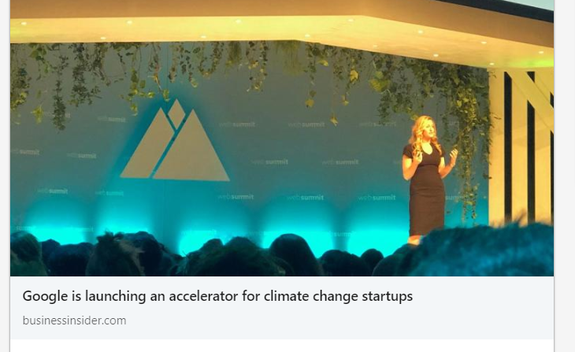

Slide 46
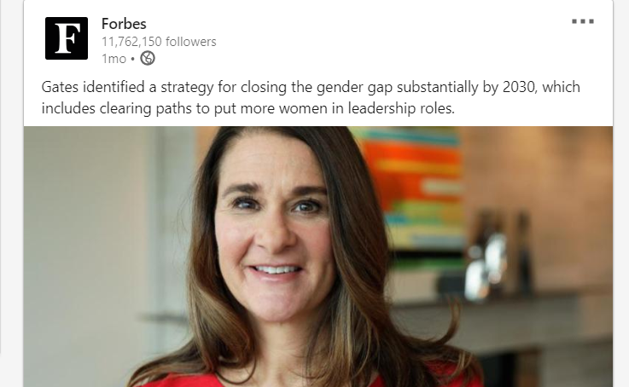

Slide 47
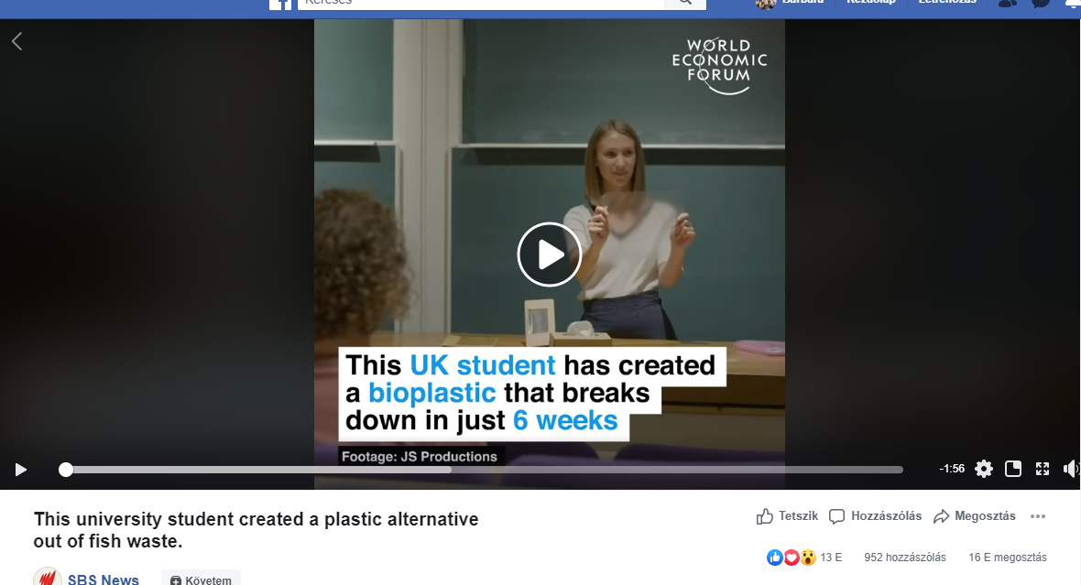

Slide 48
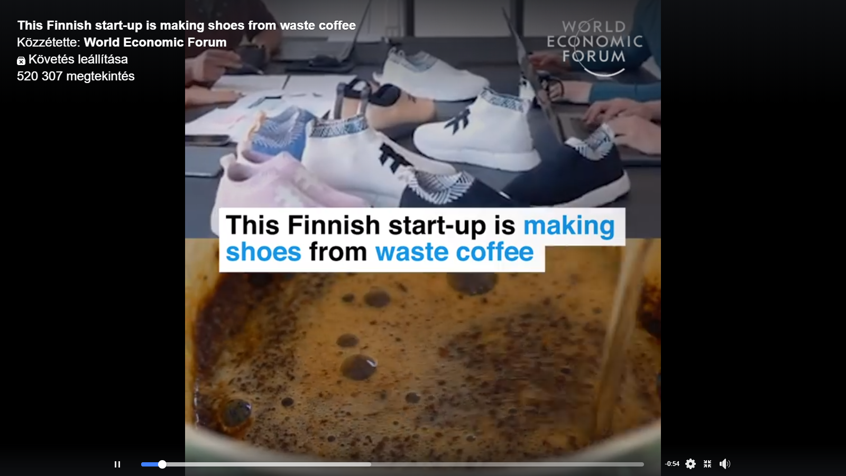

Slide 49
What about challenges?

Slide 50
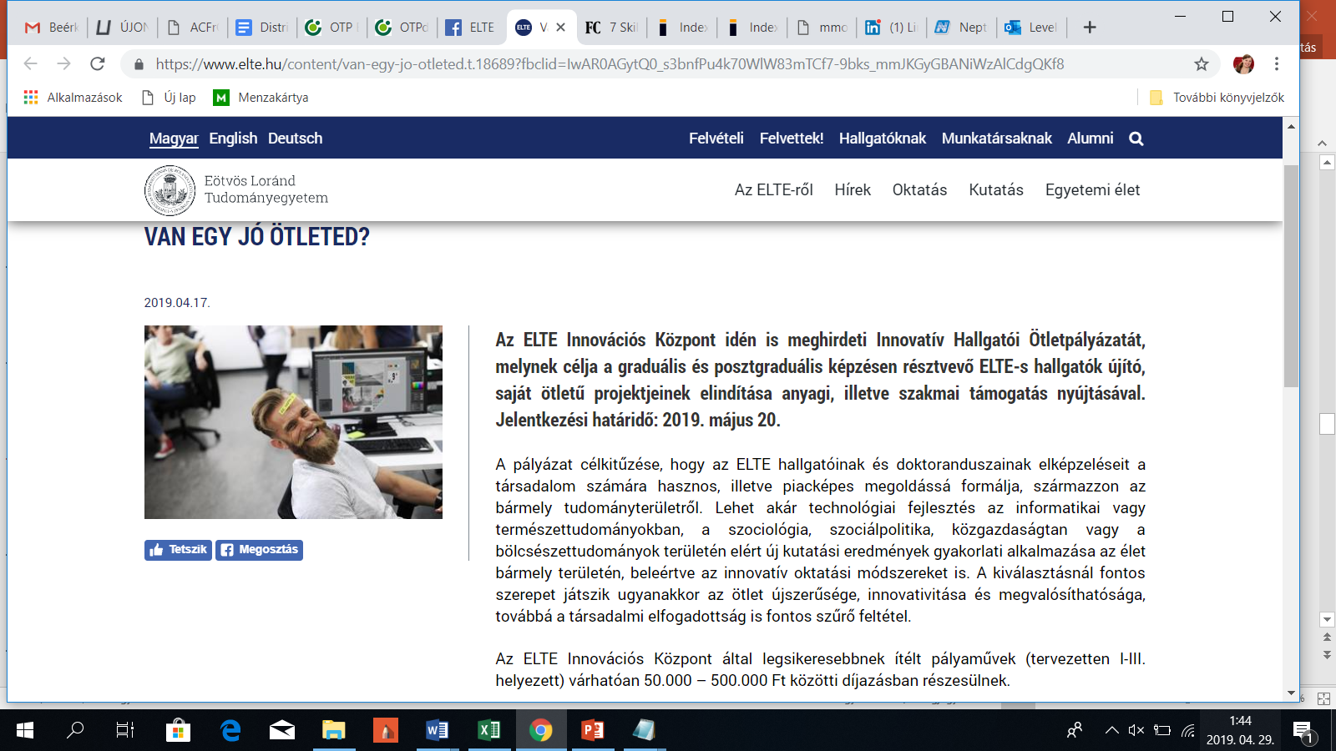

Slide 51
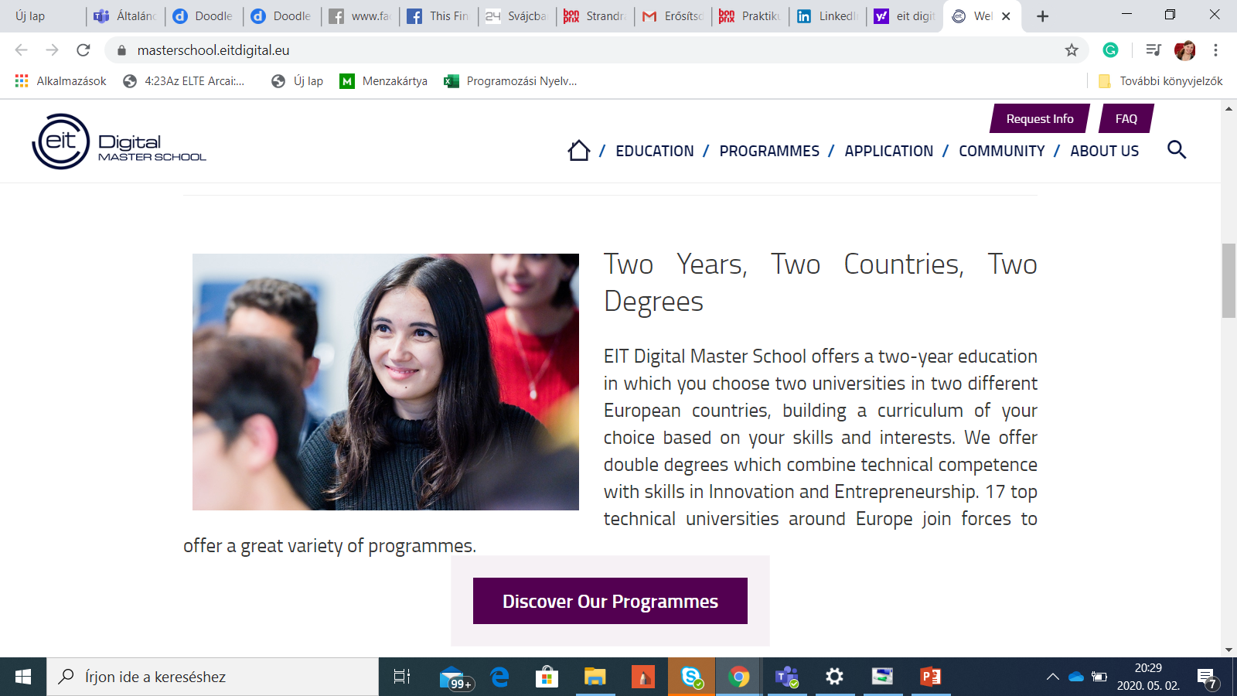

Slide 52
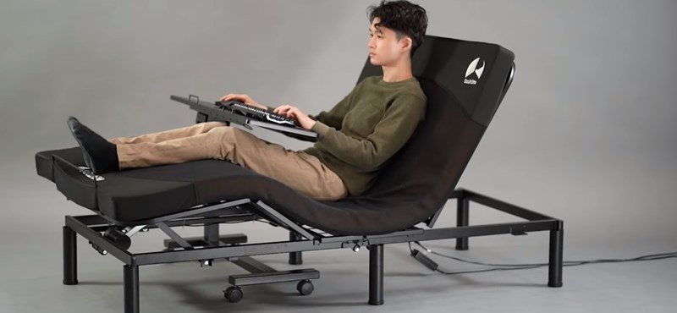





Intel CEO Thinks Chip Shortage Will Stretch to 2024

Slide 53



Slide 54



Slide 55
Why so many team assigments…?

Slide 56

7 Skills Managers Will Need In 2025
Change will be happening so quickly that 50% of the occupations that exist today will not exist 10 years from now. So we’re going to be living in an environment that is extremely adaptable and changing all the time,”
Technology management skills
Outcentric leadership skills
Tension-tolerant collaboration
Transparency
Emotional intelligence
ROWE focus (Results-Only Work Environments)
Soft-skill assessment
Forrás: https://www.fastcompany.com/40451582/7-skills-managers-will-need-in-2025

Slide 57
Why this lecture and these examples?

Slide 58
Examples and theorethical interdependencies
Existing technology – extend the field or way of usage
Boost up existing devices
Understand the problems of the users
Offer better, quicker or just more convenient solutions
Target new groups of customers with specific needs
Circular economy or sustainability as key success factors
….these are only a few ways how innovation can happen and lead to a breakthrough ….

Slide 59


Slide 60


Köszönöm az érdekes ötleteket és beszélgetéseket! Thanks for the very interesting ideas and discussions!
bhegyi@inf.elte.hu

